Slide 1
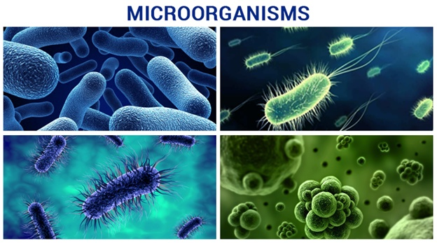

Slide 2
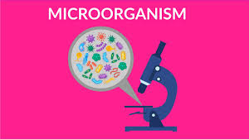
Organisms that are so small that they can only be seen through a microscope are called microorganisms or microbes.

Slide 3
Bacteria
Bacteria are found in three different shapes:
rod shaped , called bacilli
Spherical , called cocci
Spiral , called spirilla
Vibrio, called comma shaped

Slide 4
ALGAE
CHARACTERISTICS OF ALGAE:
Algae are eukaryotic organisms
Mostly photosynthetic
They are almost marine , very few are freshwater.
Algae can be unicellular or multicellular.
Algae reproduce either by vegetative , asexual or sexual methods.

Slide 5
PROTOZOA
Characteristics of protozoa:
Protozoa are unicellular
Organisms that have animal like characteristics.
They are eukaryotic microorganisms.
They can move from place to place.
Some protozoa live in fresh or salty water while others live in soil.

Slide 6
FUNGI
Characteristics of fungi:
Fungi are plant like organisms that do not contain chlorophyll.
They may be unicellular or multicellular.
They grow best in dark , warm and moist places.
G

Slide 7
VIRUSES
Characteristics of viruses:
Viruses can replicate only by
infecting a host cell.
They cannot reproduce on their own.
They infect a wide variety of organisms
, including both eukaryotes and prokaryotes.

Slide 9
BENEFICIAL MICROORGANISMS
In food and beverage industry
• Lactobacillus is a bacterium that sours milk and is used to prepare curd from milk.
• Fungi like mushrooms and morels are edible and are rich source of protein.
• Yeast is used in preparing food items like bread and cakes.
(Dough making using yeast and flour)
• Yeast is also used in breweries for making alcohol, wines and acetic acid
(commercial use) by the process of fermentation (conversion of sugar into
alcohol). Yeast is grown on natural sugars present in grains like barley,
wheat, rice, crushed fruit juices, etc.
(Alcohol preparation using sugar solution and yeast)
Louis Pasteur discovered fermentation in 1857

Slide 10
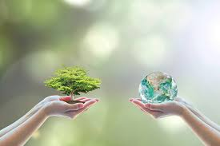
IN AGRICULTURE
• Some bacteria (Rhizobium) and blue green algae (Nostoc) live in the root nodules of plants such as gram, pea (leguminous plants) etc. These bacteria absorb the nitrogen from the atmosphere and convert it into nitrate which serves as natural fertilizers for plants, hence, enhancing soil fertility.
• These microbes are commonly called as biological nitrogen fixers.

Slide 11
The alcohol as sugar has been converted into alcohol by yeast. This process of conversion of sugar into alcohol is known as FERMENTATION.

Slide 12
IN CLEANING THE ENVIRONMENT
• The microorganisms decompose dead organic waste of plants and animals
converting them into simple substances. These substances are again used
by other plants and animals.
• Thus, microorganisms can be used to degrade the harmful and smelly
substances and thereby clean up the environment.
• The plant waste can be converted into manure by the action of microbes.
The nutrients released in the process can be used by the plants again.
(Making manure using plant waste, fruit and vegetable
peels vs. plastic waste, e-waste)

Slide 13
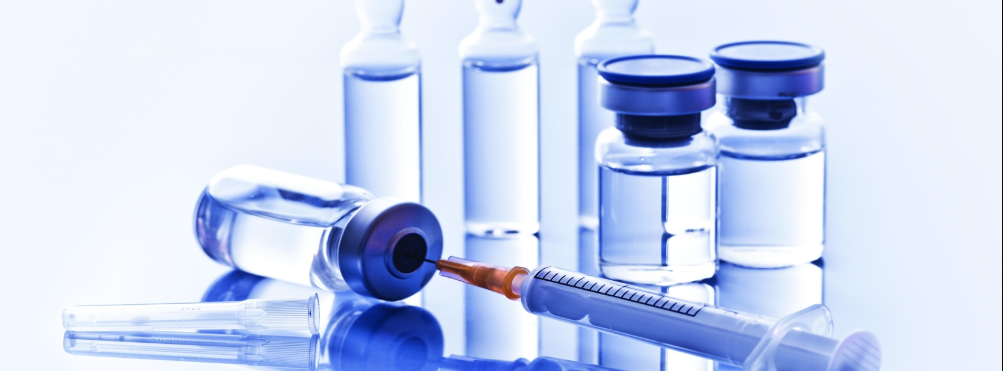
IN MAKING MEDICINES - VACCINES
• When a disease-carrying microbe enters our body, the body
produces antibodies to fight the invader.
• The body also remembers how to fight the microbe if it enters again.
• So, if dead or weakened microbes are introduced in a healthy body, the body fights and kills them by producing suitable antibodies.
• The antibodies remain in the body and we are protected from the disease-causing microbes. This is how a vaccine works.
• Diseases like cholera, tuberculosis, smallpox and hepatitis can be prevented by vaccination.

Slide 14
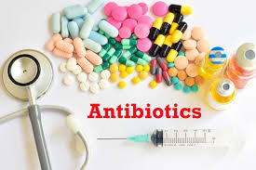
IN MAKING MEDICINES-ANTIBIOTICS
• Antibiotics are medicines which kill or stop the growth of the disease-causing microorganisms.
• A number of antibiotics are being produced from bacteria and fungi.
Ex: Streptomycin, tetracycline, erythromycin
• Antibiotics are mixed with the feed of livestock and poultry to check microbial infection in animals.
• They are also used to control many plant diseases.
• Antibiotics are not effective against cold and flu as these are caused by viruses.
Note: Antibiotics should be taken only on the advice of a qualified doctor and the prescribed course should be completed.

Slide 15
Mindmap

Slide 16
THANK YOU

